Slide 1
unique raw materials × innovation
for avant-garde quality
Refractories for the cement industry

Slide 2
contents
1
2
3
who we are
what we offer
how we work
Magnezit Group
avant-grade quality
integrated approach
geography
unique equipment
key advantages of our solutions
development
advanced technology
modernization program
innovative products
Russian Magnezit
universal RMAG product line
RMAG Top category
RMAG High category
RMAG Standard category

Slide 3
1
experience × inspiration
for achievements
who we are

Slide 4

1. who we are
An international vertically integrated company with Russian roots
Magnezit Group
our competencies
a technological leader in the domestic industry
the number one manufacturer of magnesia-based refractories in Russia and the CIS
one of the largest refractory manufacturers worldwide
production and distribution of refractory materials
innovation-driven engineering and comprehensive services for thermal vessels
production and distribution of materials based on magnesite and other own raw materials
our advantages
founded in 1901
backbone enterprise in Satka monotown, Chelyabinsk Region
100% self-sufficiency in terms of raw materials for over 100 years down the line
full-cycle production
innovative products and solutions
coverage for all high potential global markets

Slide 5
1. who we are
Russia
Extraction and production
Satka production site, Satka,
Chelyabinsk Region — the company’s production centerpiece
Nizhne-Priangarsk production site, Razdolinsk – extraction and processing of unique Siberian magnesite
Service
Magnezit Montazh Servis, Satka
Trade representations
Moscow, Saint Petersburg, Chelyabinsk, Magnitogorsk, Ekaterinburg, Novokuznetsk, Orsk, Nizhny Tagil, Nizhny Novgorod, Krasnoyarsk, Taganrog
Worldwide
Extraction and production
Slovmag a.s., Lubenik, Slovakia
Liaoning Dalmond Refractories, Yingkou, Laobian District, China
Service
Magref, Ukraine
Aziya-Ogneupor, Kazakhstan
Distribution*
Magnezit Group Europe, worldwide
Dalmond Trade House, worldwide
TIMAB Magnesium, EU
Traxys, USA
Mitsui, Japan
Magref, Ukraine
geography
*Partners and distribution regions.

Slide 6
1. who we are
Key focus areas
of the Development Strategy up until
2025
development
modernization and innovation
resource saving and energy efficiency
environmental safety
constructive partnerships
social responsibility

Slide 7
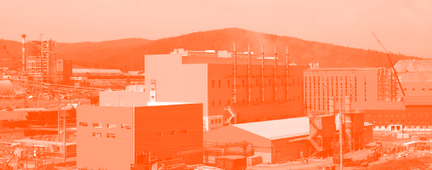
1. who we are
Key focus areas
of the Development Strategy up until
2025
development
modernization and innovation
Boost qualitative shifts in production capacity and processes to deliver high-quality innovative products with high added value
resource saving and energy efficiency
environmental safety
constructive partnerships
social responsibility

Slide 8
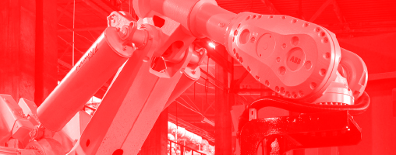
1. who we are
Key focus areas
of the Development Strategy up until
2025
development
modernization and innovation
resource saving and energy efficiency
Ensure rational and efficient use of production resources (raw materials, energy, etc.) to reduce capital and material intensity for end products and improve labor productivity and product quality
environmental safety
constructive partnerships
social responsibility

Slide 9

1. who we are
Key focus areas
of the Development Strategy up until
2025
development
modernization and innovation
resource saving and energy efficiency
environmental safety
Minimize environmental impact and ensure top production safety levels to protect human life and health
constructive partnerships
social responsibility

Slide 10

1. who we are
Key focus areas
of the Development Strategy up until
2025
development
modernization and innovation
resource saving and energy efficiency
environmental safety
constructive partnerships
Build partnerships with all stakeholder groups based on the principles of good faith, honesty, mutual trust and respect, professionalism, sanctity of contract, and information transparency
social responsibility

Slide 11

1. who we are
Key focus areas
of the Development Strategy up until
2025
development
modernization and innovation
resource saving and energy efficiency
environmental safety
constructive partnerships
social responsibility
Respect the interests of employees, ensure decent working conditions and social and spiritual well-being in the community, and stimulate socio-economic development of regions where the company operates

Slide 12
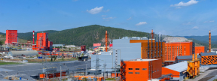
1. who we are
The modernization program encompasses the entire production cycle and aims to stimulate innovation in key points of growth that determine not only our future but also the future of the entire industry.
modernization program
total investments under the Global Technological Modernization Program up until 2025
objectives
strengthen the competitiveness of the Group’s products
increase production volumes
expand the product mix
introduce modern technology
automate and robotize processes
save resources and improve energy efficiency
minimize environmental impact
34
bn rubles
20%
in green production and environmental initiatives

Slide 13

1. who we are
Russian Magnezit is fused and dead-burned magnesia with an MgO content of up to
98,5%
Russian Magnezit
produced from the unique Siberian magnesite via a double-step technology.
The modernization program enables the Group to attain a significant growth in production volumes for both Russian Magnezit and innovative derivative products.
Russian Magnezit fused magnesia
20 000
metric tons p.a.
Russian Magnezit can be used for manufacturing a wide range of high-performance refractory products for thermal vessels required by various industries.
90 000
metric tons p.a.
Russian Magnezit dead-burned magnesia
5 000
metric tons p.a.
* Total output for Satka and
Nizhne-Priangarsk production sites.
learn more
50 000
metric tons p.a.
about the
Russian Magnezit

Slide 14
2
unique raw materials × innovation
for
avant-garde quality
what we offer

Slide 15
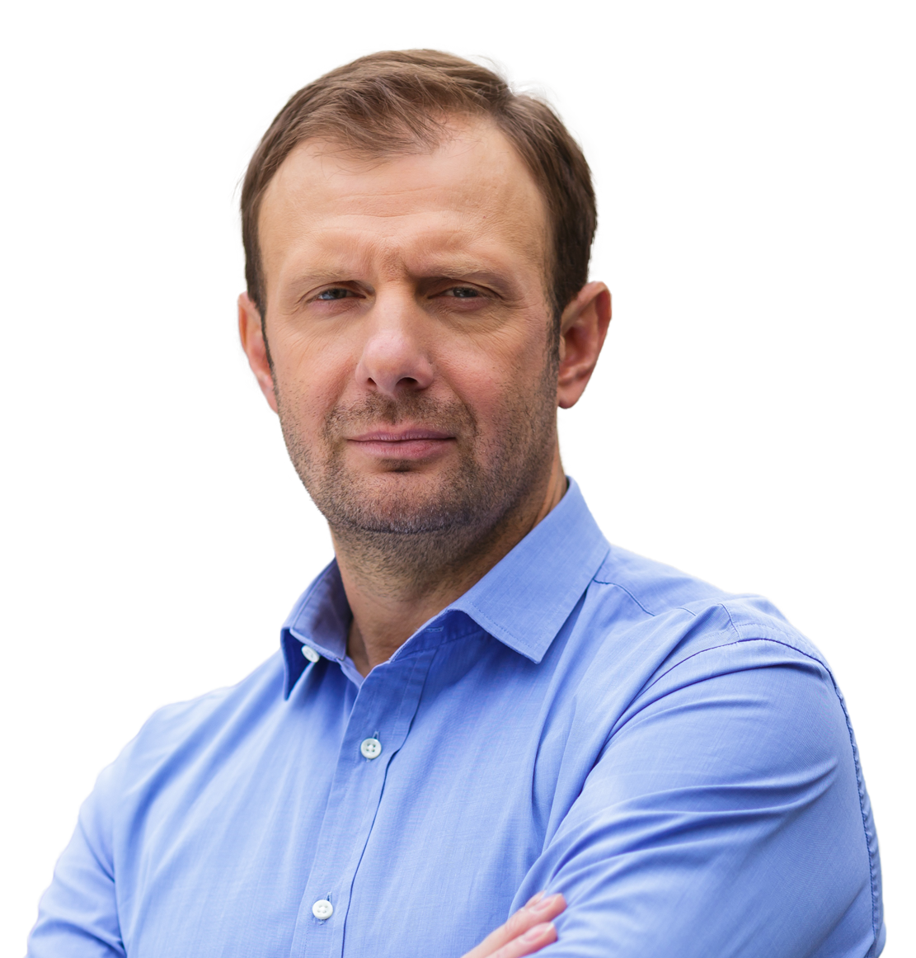
2. what we offer
Focus on cutting-edge Russian-made refractories for the cement industry
avant-garde quality
target results
«We offer an innovative line of RMAG refractories for the cement industry based on a unique mineral filler – Russian Magnezit. Cutting-edge production equipment guarantees top quality of each piece».
for clients and partners
stable high quality of products
independence from market fluctuations and the global political climate
advancements in production
Sergey Odegov
general director, Magnezit Group

Slide 16
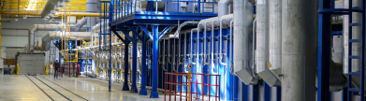

2. what we offer
The production line serving the needs of the cement industry is a part of Impulse, a modern production facility.
unique equipment
Location:
Satka production site, Impulse facility
Products:
magnesia-spinel refractories of various mixtures
Line capacity:
production line for refractories for the cement industry
Unique features of the production line
LAEIS hydraulic presses
ABB robot solutions
Riedhammer tunnel kiln
Omega Impulse 40
end-to-end line automation — from mixing to labeling and packaging.
optimized logistics with fully localized equipment.
uniform firing in an energy-efficient kiln.
external and internal defect control for each item.
minimizing the impact of the human factor.
40 000 tpa
Commissioned
in July 2021
automatic sorting and packaging facility
100%
compliance with environmental standards
how the production line works

Slide 17
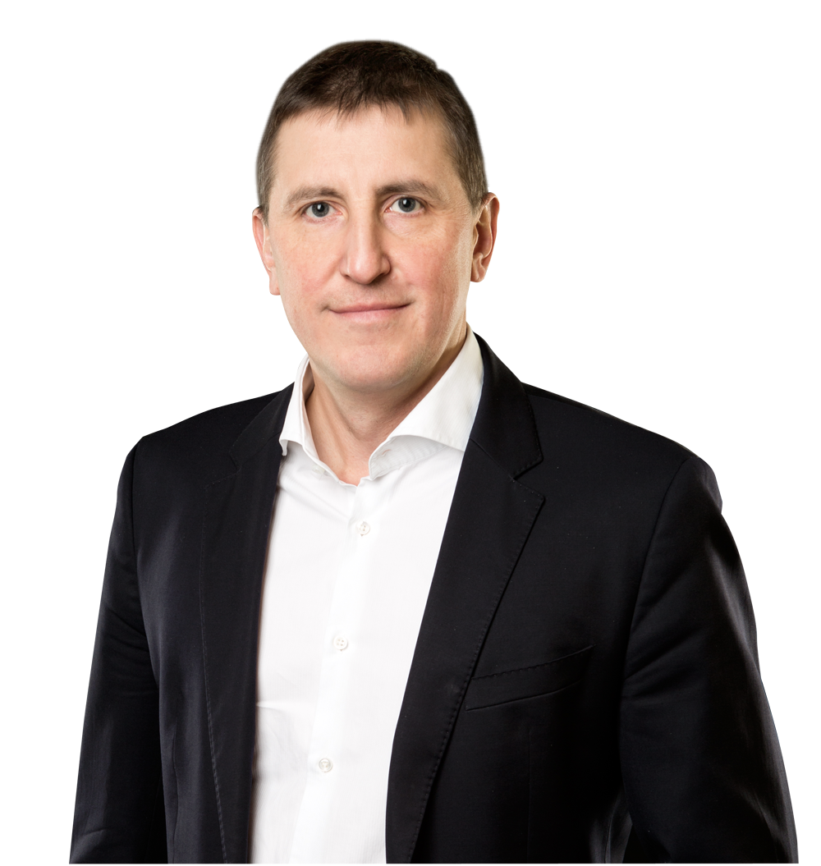
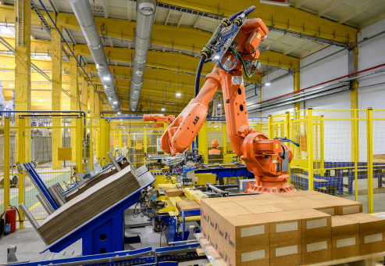

2. what we offer
Robotized automatic sorting and packaging facility
advanced technology
The automatic sorting and packaging facility is a joint creation of Magnezit Group and experts representing several foreign companies. All the processes, including analysis, sorting, labeling, and packaging for all items are integrated and fully automated to rule out the human factor.
“The sorting and packaging facility installed on the production line serving the needs of the cement industry is one of its kind worldwide in terms of both the degree of automation and the depth of quality control.”
Dmitry Borzov
Development Director, Magnezit Group
how the sorting facility works

Slide 18
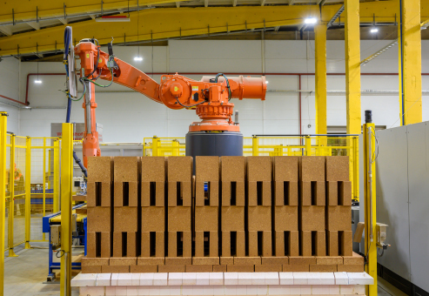
2. what we offer
Robotized automatic sorting and packaging facility
advanced technology
The automatic sorting and packaging facility is a joint creation of Magnezit Group and experts representing several foreign companies. All the processes, including analysis, sorting, labeling and packaging for all items are integrated and fully automated to rule out the human factor.
analysis and sorting
labeling
packaging
external and internal defect control in the test chamber for each item
internal defects analy-sis — ultrasonic testing
external parameter analysis: 48 visual parameters
clock speed — 4.9 se-conds per 1 item
continuous lab analysis
3 types of labeling continuously applied: thermal pads, color labeling, and coding
2 cameras used for labeling control
corrugated box and stretch wrap
cardboard layers added between every 2 rows
QR coding for each pallet
safety guaranteed for all delivery options
how the production line works

Slide 19
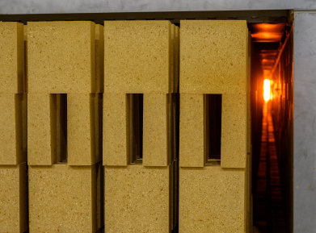
2. what we offer
Russian Magnezit, dead-burned magnesia, is used as the main mineral filler for RMAG products.
innovative products
RMAG categories have different levels of resistance to thermal, mechanical, and chemical loads.
RMAG Top
— extremely high and very high resistance
RMAG High
— high resistance
RMAG Standard
— standard resistance
learn more about Russian Magnezit

Slide 20

2. what we offer
innovative products
RMAG Top
Fired magnesia-spinel products with extremely high and very high resistance to thermal, mechanical and chemical loads
Intended for dry kilns and can be used in extremely severe and very severe conditions.
Product labeling example for RMAG T1 type/size B622
mixture specifics
dead-burned magnesia Russian Magnezit
fused alumina-magnesium spinel
low levels of impurity oxides
functional properties
high resistance to thermal loads
corrosion resistance
high abrasion resistance
high resistance to chipping
conditions of use
high levels of alkali oxides
highly corrosive environment
extremely high thermal loads
unstable coating
high abrasive wear
use of aggressive alternative fuel (AF)

Slide 21
2. what we offer
innovative products
RMAG Top
Fired magnesia-spinel products with extremely high and very high resistance to thermal, mechanical, and chemical loads
Intended for dry kilns and can be used in extremely severe and very severe conditions
Physical properties and chemical analysis | RMAG-Т1 | RMAG-Т11 | RMAG-Т2 | RMAG-Т21 | RMAG-Т3 | RMAG-Т31 | RMAG-Т1Z | RMAG-Т2Z
Content, %
MgO | 86.0 | 88.0 | 85.5 | 90.0 | 85.0 | 89.0 | 85.0 | 85.0
Al₂O₃ | 12.0 | 10.0 | 12.0 | 7.5 | 12.0 | 7.7 | 11.0 | 11.0
SiO₂ | 0.4 | 0.4 | 0.5 | 0.5 | 0.6 | 0.6 | 0.4 | 0.5
CaO | 0.8 | 0.8 | 1.0 | 1.0 | 1.2 | 1.2 | 0.8 | 1.0
Fe₂O₃ | 0.7 | 0.7 | 0.8 | 0.8 | 0.8 | 0.8 | 0.7 | 0.8
ZrO₂ | – | – | – | – | – | – | 1.8 | 0.5
Open porosity, % | 15.0 | 15.0 | 150 | 15.0 | 15.5 | 15.5 | 15.0 | 15.0
Сrushing strength, N/mm³ | 60 | 60 | 60 | 60 | 60 | 60 | 60 | 60
Refractoriness under load, °С (ISO 1893-89 in Т₀₅) | 1 700 | 1 700 | 1 700 | 1 700 | 1 700 | 1 700 | 1 700 | 1 700
Thermal shock resistance, air, number of coolings (GOST R 52542-2006, EN 993-11) | 100 | 80 | 100 | 80 | 100 | 80 | 100 | 100
Thermal shock resistance, water, number of coolings (GOST 7875.0-2018, GOST 7875.1-2018) | 25 | 15 | 25 | 15 | 25 | 15 | 25 | 25
The typical data represent results of testing samples in accordance with the valid standards. These values are not obligatory. We reserve the right for other technical development and related changes of product parameters.

Slide 22

2. what we offer
innovative products
RMAG High
Fired magnesia-spinel products with high resistance to thermal, mechanical, and chemical loads
Intended for dry and wet kilns and can be used in severe conditions
mixture specifics
dead-burned magnesia Russian Magnezit
fused alumina-magnesium spinel
may additionally contain chrome ore
optimal levels of impurity oxides
functional properties
adequate coating reception capacity
highly elastic (flexible) structure
refractoriness
conditions of use
elevated levels of alkali oxides
high to moderate chemical loads
high mechanical and thermal loads
unstable coating
partial use of alternative fuel (AF)

Slide 23
2. what we offer
innovative products
RMAG High
Fired magnesia-spinel products with high resistance to thermal, mechanical and chemical loads
Intended for dry and wet kilns and can be used in severe conditions
Physical properties and chemical analysis | RMAG-Н1 | RMAG-Н11 | RMAG-H1C | RMAG-Н2 | RMAG-H2С
Content, %
MgO | 85.0 | 89.0 | 86.0 | 84.0 | 86.0
Al₂O₃ | 12.0 | 7.7 | 7.0 | 12.0 | 6.0
SiO₂ | 0.7 | 0.7 | 0.8 | 0.8 | 1.0
CaO | 1.4 | 1.4 | 1.5 | 1.4 | 1.5
Fe₂O₃ | 0.9 | 0.9 | 2.0 | 1.0 | 3.0
ZrO₂ | – | – | 2.1 | – | 2.4
Open porosity, % | 16.0 | 16.0 | 16 | 16 | 16
Сrushing strength, N/mm³ | 65 | 65 | 60 | 60 | 60
Refractoriness under load, °С (ISO 1893-89 in Т₀₅) | 1 690 | 1 690 | 1 680 | 1 680 | 1 680
Thermal shock resistance, air, number of coolings (GOST R 52542-2006, EN 993-11) | 100 | 80 | 90 | 100 | 80
Thermal shock resistance, water, number of coolings (GOST 7875.0-2018, GOST 7875.1-2018) | 25 | 15 | 20 | 25 | 20
The typical data represent results of testing samples in accordance with the valid standards. These values are not obligatory. We reserve the right for other technical development and related changes of product parameters.

Slide 24

2. what we offer
innovative products
RMAG Standard
Fired magnesia-spinel products with standard resistance to thermal, mechanical and chemical loads
Mainly intended for wet kilns and some areas of dry kilns under normal operating conditions
mixture specifics
dead-burned magnesia
dead-burned magnesia Russian Magnezit
fused alumina-magnesium spinel
optimal levels of impurity oxides
functional properties
coating holding capacity
moderate refractoriness and resistance to mechanical loads
conditions of use
stable environment
standard thermal loads
moderate mechanical loads

Slide 25
2. what we offer
innovative products
RMAG Standard
Fired magnesia-spinel products with standard resistance to thermal, mechanical, and chemical loads
Mainly intended for wet kilns and some areas of dry kilns under normal operating conditions
Physical properties and chemical analysis | RMAG-S1 | RMAG-S2 | RMAG-S3
Content, %
MgO | 85.0 | 84.0 | 84.0
Al₂O₃ | 11.0 | 11.0 | 10.0
SiO₂ | 1.0 | 1.5 | 1.7
CaO | 1.5 | 1.9 | 2.0
Fe₂O₃ | 1.3 | 1.5 | 2.0
Open porosity, % | 16.0 | 16.0 | 17.0
Сrushing strength, N/mm³ | 60 | 55 | 55
Refractoriness under load, °С (ISO 1893-89 in Т₀₅) | 1 670 | 1 640 | 1 560
Thermal shock resistance, air, number of coolings (GOST R 52542-2006, EN 993-11) | 90 | 80 | 80
Thermal shock resistance, water, number of coolings (GOST 7875.0-2018, GOST 7875.1-2018) | 20 | 15 | 15
The typical data represent results of testing samples in accordance with the valid standards. These values are not obligatory. We reserve the right for other technical development and related changes of product parameters.

Slide 26
3
experience × inspiration
for achievements
how we work

Slide 27
3. how we work
We possess a full range of competencies to offer an integrated approach to addressing our customers’ needs.
integrated approach
in-house production
engineering
service
logistics
recycling

Slide 28
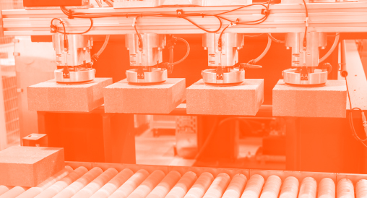
3. how we work
We possess a full range of competencies to offer an integrated approach to addressing our customers’ needs.
integrated approach
in-house production
RMAG refractories
shotcrete and filling mixtures for rotary kilns, cyclone preheaters, decarbonizers, grate coolers, burners, and other units
metal and ceramic anchors
block-based items
engineering
service
logistics
recycling

Slide 29
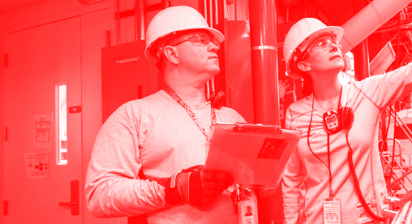
3. how we work
We possess a full range of competencies to offer an integrated approach to addressing our customers’ needs.
integrated approach
in-house production
engineering
modernization of thermal vessels and production lines and design of new ones
custom design of linings and metal structures for thermal vessels
3D models of thermal vessels
thermal and strength analysis of thermal vessel structures using the ANSYS software
service
logistics
recycling

Slide 30

3. how we work
We possess a full range of competencies to offer an integrated approach to addressing our customers’ needs.
integrated approach
in-house production
engineering
service
field supervision at the stage of lining installation works with due regard to the customer’s requirements
end-to-end monitoring of refractory works, lining condition, parameters, and operating modes
provision of auxiliary equipment for lining installation and maintenance
training courses for technical staff
a full range of refractory works, including provision of the necessary equipment
logistics
recycling

Slide 31

3. how we work
We possess a full range of competencies to offer an integrated approach to addressing our customers’ needs.
integrated approach
in-house production
engineering
service
logistics
a unique packaging system ensuring maximum protection during transshipment and storage
delivery by any transport to any location worldwide
recycling

Slide 32

3. how we work
We possess a full range of competencies to offer an integrated approach to addressing our customers’ needs.
integrated approach
in-house production
engineering
service
logistics
recycling
a recycling program for used linings and their reuse for various needs

Slide 33
3. how we work
key advantages of our solutions
quality assurance
We run quality checks for each item
stable supplies
We use our own raw materials to manufacture products at our own plants
lining durability
We offer products with minimum porosity and gas permeability, maximum refractoriness and structural flexibility
rational solutions
We can help you find the right product, mixture, and properties for each lining
production efficiency
We strive to minimize unit costs for end products and reduce market volatility risks
green processes
Our products will help you extend the life cycle of your thermal vessels and reduce your environmental impact
based on RMAG products for the cement industry

Slide 34

thank you
Representation in Moscow:
Bolshaya Polyanka St., Bldg. 3, Moscow, Russia, 119180
(495) 232-61-00
msk@magnezit.com
info@magnezit.com
vustinov@magnezit.com
Magnezit Group website

